Slide 1
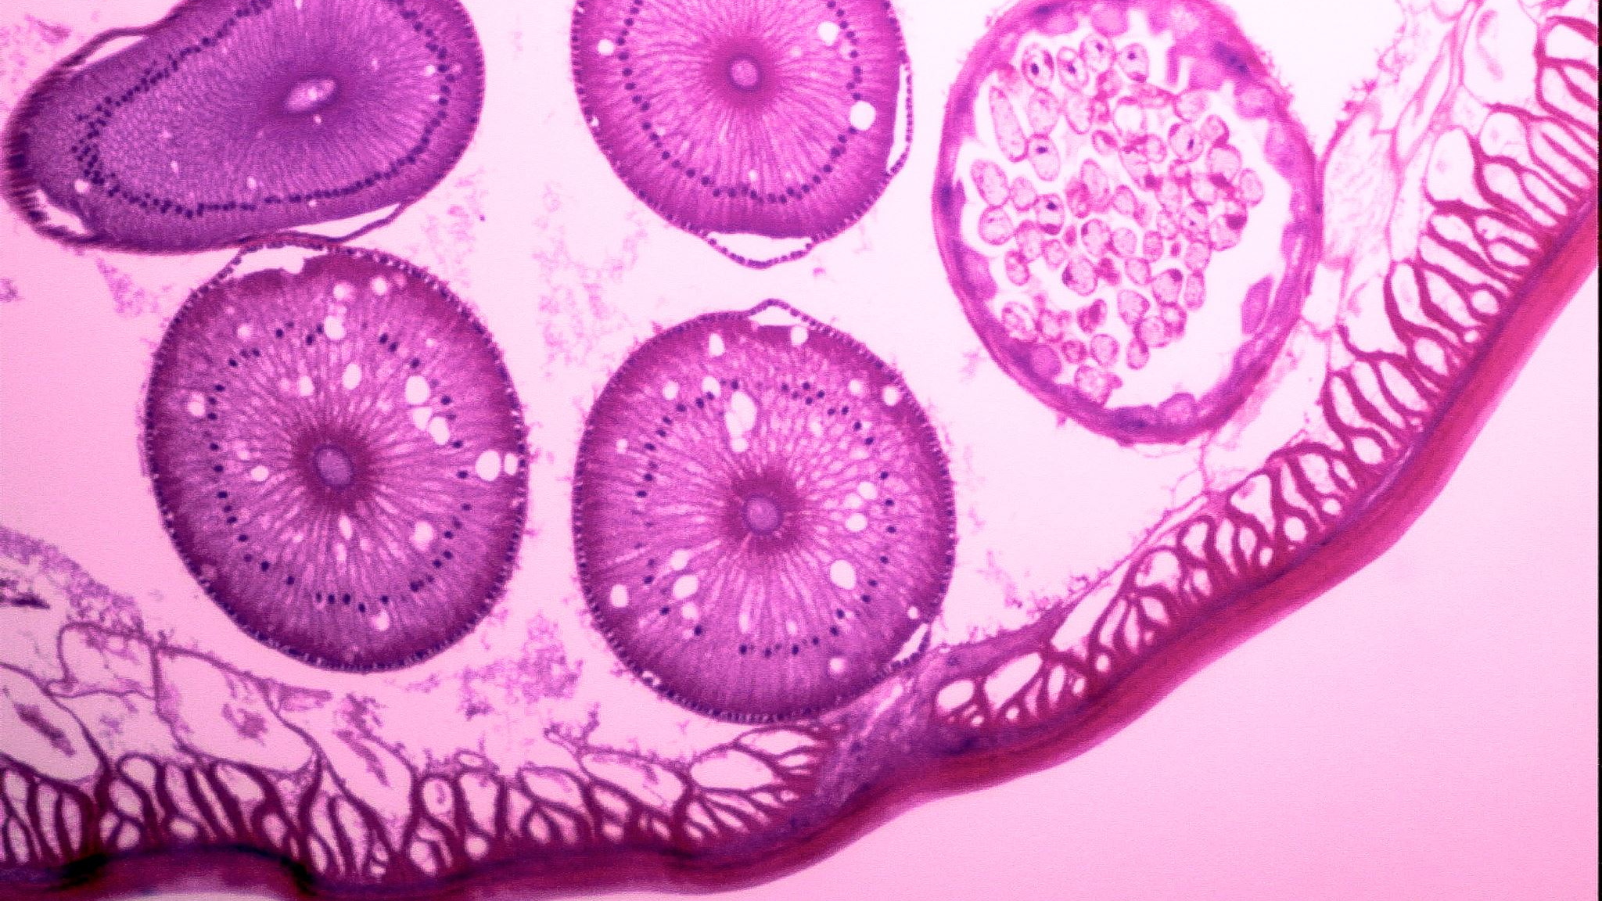
Classification of White Blood Cells through CNNs
Arman Siddiqui, Katie Rodeghiero, Connor Lydon

Slide 2
There’s something in the blood!
CBC (complete blood count) is needed to identify the presence and quantity of WBCs (white blood cells) in a body
CBC’s require lab equipment and can’t be used everywhere
Using image classification to ID and quantify the presence of white blood cells makes doing basic CBC functions in remote settings easily accessible
Field cases, military applications, humanitarian efforts, supplemental to clinical environments, etc.
White Blood Cell Types:
Eosinophil
Lymphocyte
Monocyte
Neutrophil
Basophil*

Slide 3
State of the Art Solutions
Current state of the art solutions focus more on blood cell classifications with respect to cancers
Approaches include:
Hybrid classifications using CNNs for feature extraction then Salp Swarm Algorithms (SESSA) to extract only needed information
Using Canonical Correlation Analysis (CCA) via CNN-LSTM architectures
CCA helps with overlapping cell paths/bodies in white blood cells

Slide 4
Importance
Immediate and accessible WBC ID can be the difference between knowing an individual is experiencing a deadly infection and of what nature the infection is
In a remote location, getting immediate basic care can help prevent death via sepsis

Slide 5

Data Used
The data set used holds 12,500 images of the 4 major WBC classifications
Eosinophil, Lymphocyte, Monocyte, Neutrophil
Data was pre-classified and already split into training and testing sets.
A validation set was manually implemented

Slide 6
Basic EDA
The testing dataset, has roughly 620 images available each classification
The training dataset has roughly 2500 images available for each classification
A manually created validation dataset has ~20% of the images found in the training dataset

Slide 7
Transfer Learning
To help with the CNN we built, transfer learning was incorporated
The VGG16 CNN model was used to extract our classifications feature bottlenecks for recall later in our own models
VGG16 is a 16-layer CNN focused on a specific filter structure as opposed to a large quantity of hyper-parameters
An attempt to use other pretrained models such as ResNet50 were attempted but physical hardware limitations were encountered

Slide 8
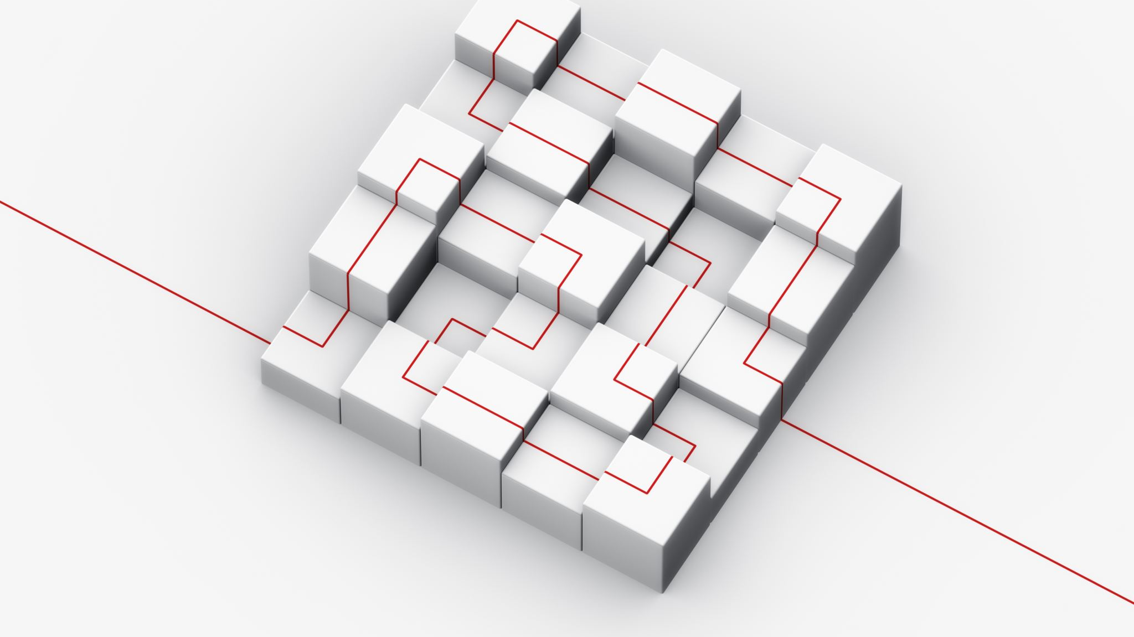
Model’s Data Preparations
Before building our own model, transfer training with VGG16 was implemented to create .npy feature files for the training, testing, and validation sets
After which the datasets were then prepared using the feature files created prior to provide our test labels for each respective dataset

Slide 9
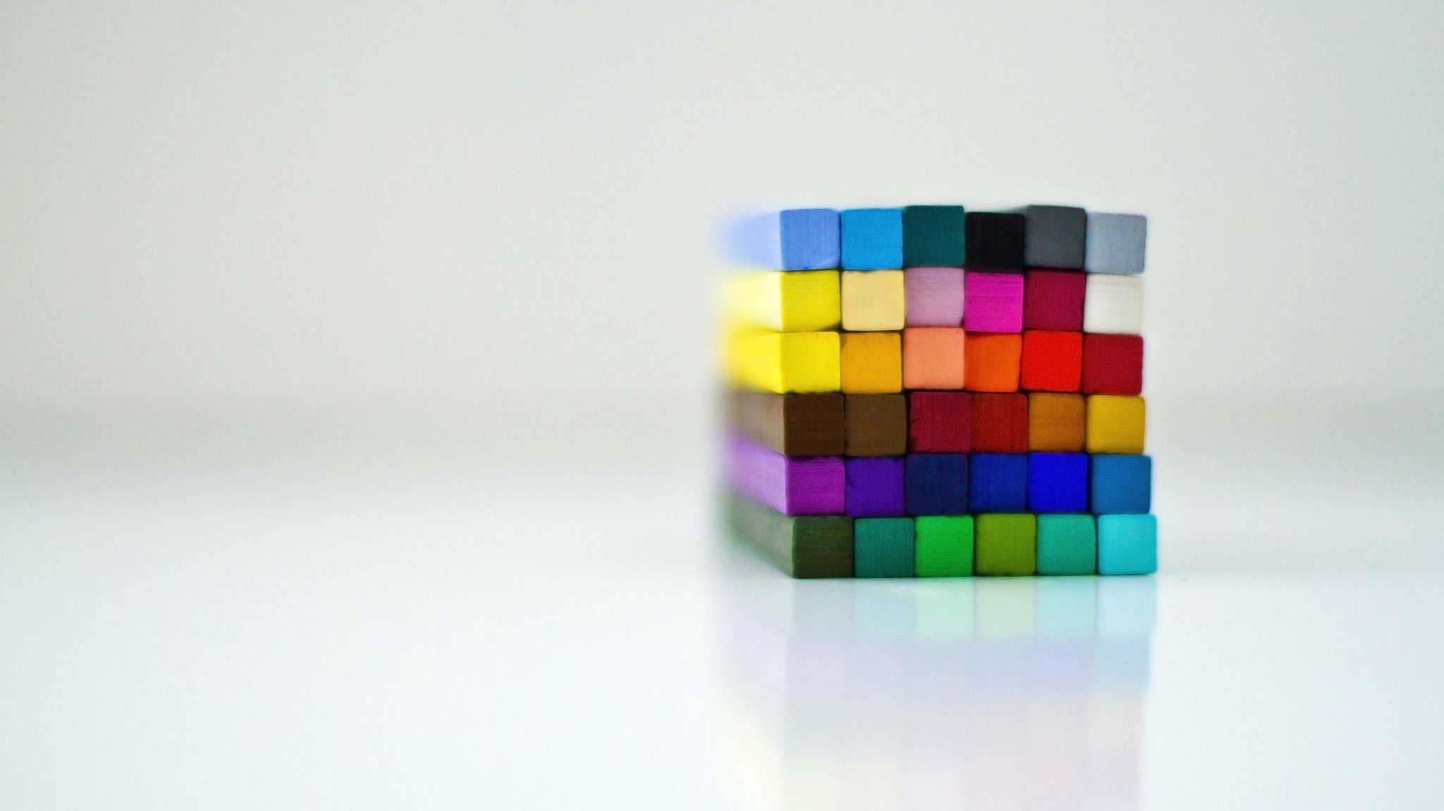
Additional Model Notes
Each model made use of regularization through dropout at all hidden layers
In addition, each model made use of Keras EarlyStopping
EarlyStopping allowed the models to finish being fit when within 3 epochs accuracy of the model didn’t improve
This meant that each variation of our model ran for a different number of epochs
Models all had a batch size of 32 as this found most optimal through testing

Slide 10
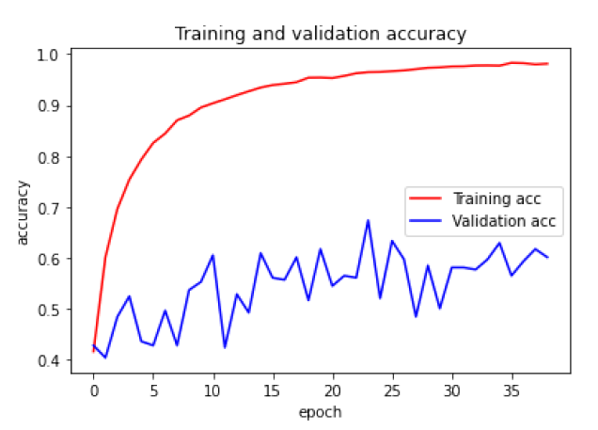
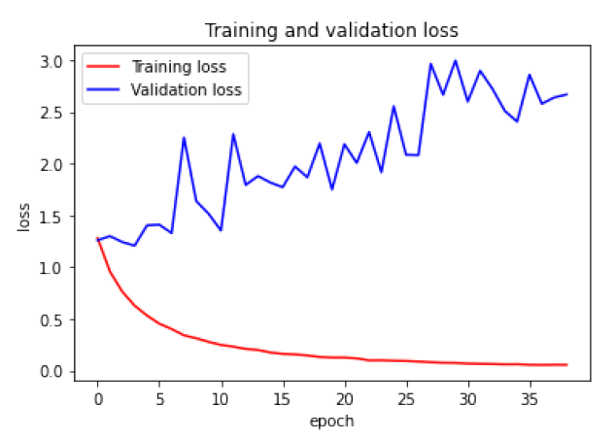
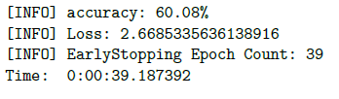
Base Model
The base model used had the following layers:
First a layer to flatten our data
2 LeakyReLU layers each with dropout to provide some form of regularization
Final dense layer with softmax activation
Notes:
LeakyReLU was selected as the activation as it helped to speed up our model training and helps address the “dying ReLU” problem

Slide 11
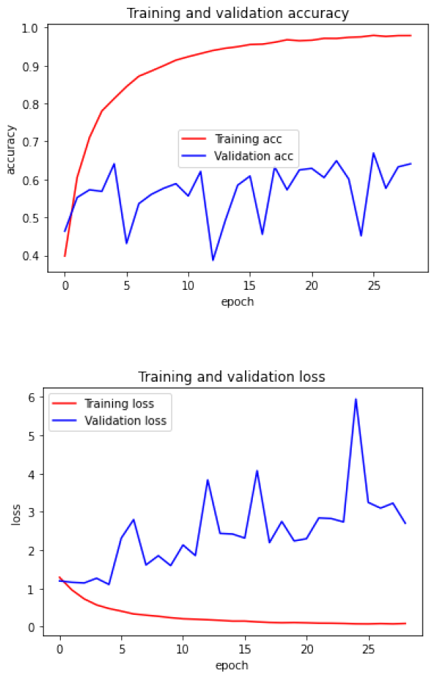

4 Hidden Layer Model
The 4 hidden layer model used had the following:
First a layer to flatten our data
4 LeakyReLU layers each with dropout to provide some form of regularization
Final dense layer with softmax activation

Slide 12
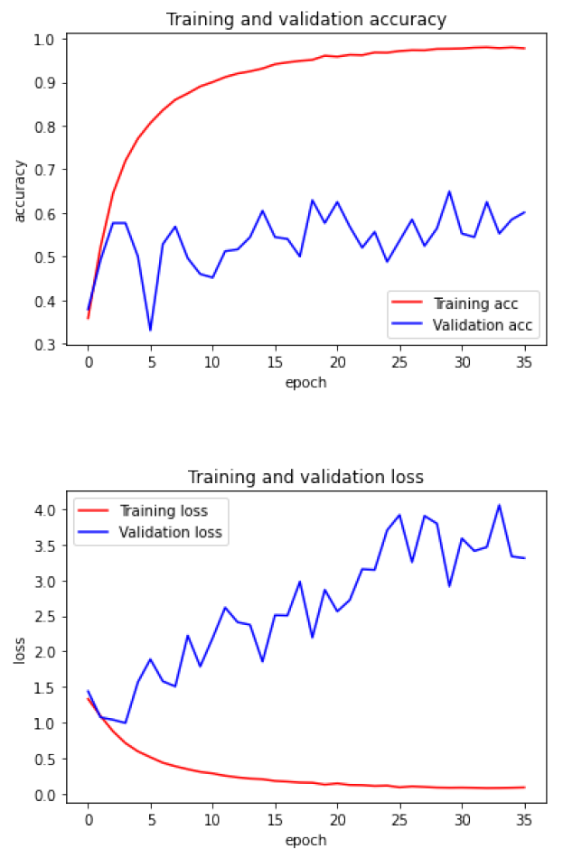

5 Hidden Layer Model
The 4 hidden layer model used had the following:
First a layer to flatten our data
5 LeakyReLU layers each with dropout to provide some form of regularization
Final dense layer with softmax activation

Slide 13
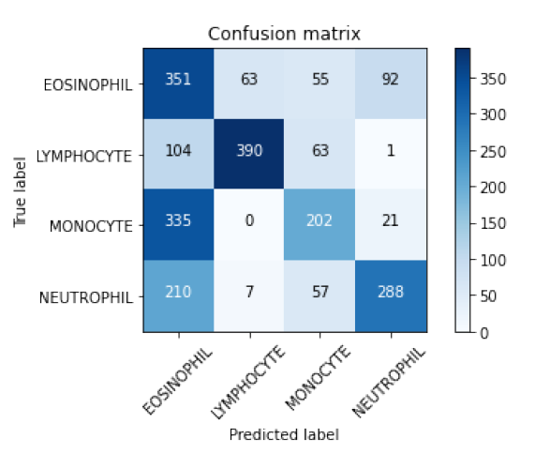
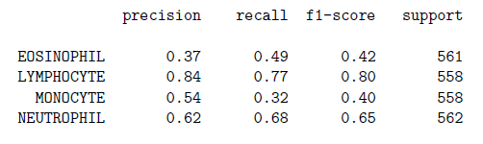
Final Model Performance/Results
The model made with 5 hidden layers was selected as the final model even when performing marginally poorer
Enough dropout, a deep enough network with a high enough layer count, trial and error showed consistent model performance with 5 hidden layers
Notes:
Precision = model’s ability to make the same prediction consistently
Recall = the ability of the classifier to find all the positive samples.
F1 = predictive performance of our model based on combining precision and recall

Slide 14


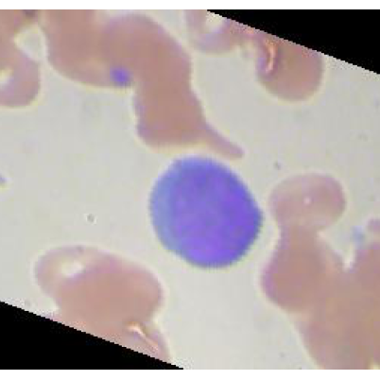
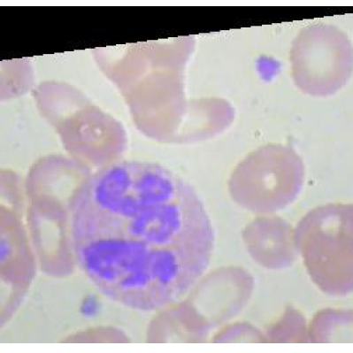
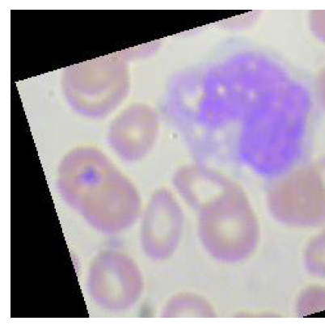
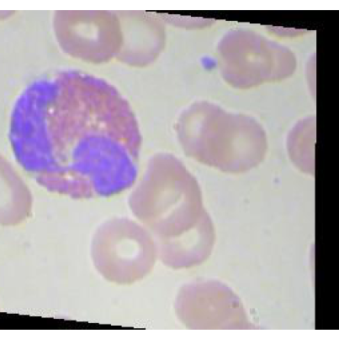
Real World Performance
Label: Lymphocyte
Confidence: 100.00%
Label: Neutrophil
Confidence: 66.86%
Label: Monocyte
Confidence: 31.76%
Label: Eosinophil
Confidence: 100.00%
Notes:
Monocyte confused with Eosinophil

Slide 15
Steps for Improvement
Incorporating even more data above the 12,500 images used in addition to implementing forms of data translation
1
Implementing better transfer training with a more robust CNN such as ResNet50
2
Attempting to build a hybrid CNN which incorporates a RNN to isolate the specific features and then move that to a CNN for classification
3
Notes:
Used as a supportive form of medicine in a clinical environment

Slide 16
References
Sahlol, A.T., Kollmannsberger, P. & Ewees, A.A. Efficient Classification of White Blood Cell Leukemia with Improved Swarm Optimization of Deep Features. Sci Rep 10, 2536 (2020). https://doi.org/10.1038/s41598-020-59215-9
Kaggle - Blood Cell Dataset
Towards Data Science - VGG16 Implementation
Towards Data Science - CNN Accuracy Improvement

